Slide 1

Lecture 4-5 CSV, Lamda function, Map, Reduce

Slide 2
Example
You are given a CSV file named "student_grades.csv," which contains the following data:
Name | Maths | Science | English
John | 85 | 78 | 92
Alice | 89 | 90 | 93
Bob | 76 | 90 | 85
Eve | 88 | 78 | 88

Slide 3
Your task is to write a Python program that reads this CSV file, calculates the average score for each student, and then creates a new CSV file named "student_average_grades.csv”
Steps to Solve
Read the data from "student_grades.csv" using CSV file handling in Python.
For each student, calculate their average score across all subjects (Maths, Science, and English).
Create average functions to calculate the average for each student.
Store the student's name and their corresponding average score in a new dictionary.
Write the data from the dictionary into a new CSV file named "student_average_grades.csv" with two columns: "Name" and "Average."

Slide 4
import csv
input_file = "student_grades.csv"
output_file = "student_average_grades.csv"
student_grades = {}
# Read data from CSV file
with open(input_file, "r") as csvfile:
reader = csv.DictReader(csvfile)
for row in reader:
name = row["Name"]
math_score = int(row["Maths"])
science_score = int(row["Science"])
english_score = int(row["English"])
score=[math_score, science_score, english_score]
average_score = sum(score) / len(scores)
student_grades[name] = average_score

Slide 5
# Write data to new CSV file
with open(output_file, "w", newline="") as csvfile:
fieldnames = ["Name", "Average"]
writer = csv.DictWriter(csvfile, fieldnames=fieldnames)
writer.writeheader()
for name, average in student_grades.items():
writer.writerow({"Name": name, "Average": average})
print("Successfully calculated and saved average grades in 'student_average_grades.csv'.")

Slide 6
Use pandas to solve this problem

Slide 7
import pandas as pd # Function to calculate average using lambda function
calculate_average = lambda scores: sum(scores) / len(scores) def main():
input_file = "student_grades.csv" # Read data from CSV file using pandas
df = pd.read_csv(input_file) # Calculate average for each student and add "Average" column
df["Average"] = df.apply(lambda row: calculate_average([row["Maths"], row["Science"], row["English"]]), axis=1)

Slide 8
# Write data back to the input CSV file with "Average" column
df.to_csv(input_file, index=False)
print("Successfully calculated and appended average grades as a new column in 'student_grades.csv'.")
if __name__ == "__main__":
main()

Slide 9
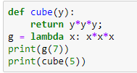
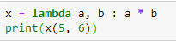
Lambda Function
lambda arguments: expression

Slide 10
Lambda function
Anonymous and don't require a formal function definition with def
Readability: For small and straightforward operations, using a lambda function
Short-lived functions: n can make the code more readable and self-contained.

Slide 11
Problem
I have a list which contains temperature in Celsius. Task is to convert Celcius to faherenheit.
i/p- [39.2, 45.5,67.9,38.3]
o/p- corresponding faherenheit

Slide 12
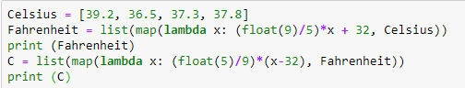
map

Slide 13
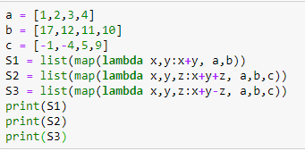

Slide 14
Problem
I am exploring company data. I want to filter out data which is currently in list form. Rule for filtration – if number is odd then accept it put into an odd list else reject it and put into an even list.

Slide 15
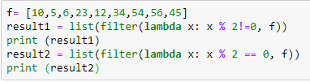
Filter

Slide 16
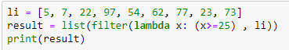

Slide 17
Problem-
In a company I am doing some task where I have to find sum of squares of the given list.
I/p- [2,3,6,5]
o/p- 2*2 +3*3 + 6*6 + 5*5 = 74

Slide 18
Reduce
from functools import reduce
li=[1,2,3,4,5,6,7]
sum= reduce((lambda x,y:x*x+y*y),li)
print(sum)

Slide 19
from functools import reduce
f=lambda a,b: a if(a>b) else b
r = reduce(f, [47,111,42,102,13])
print(r)

Slide 20
Problem Statement
You are working as a data engineer for a large retail company. Your team is responsible for processing and analyzing sales data from multiple stores across the country. The sales data is stored in CSV files, and each file represents sales data for a specific month and year. Each CSV file has the following columns:
Date (in the format "YYYY-MM-DD")
Store ID (a unique alphanumeric code)
Product ID (a unique alphanumeric code)
Quantity sold (an integer representing the number of products sold on that date)
The "product_names.csv" file has two columns: "Product ID" and "Product Name," and it contains the mapping for all products in the sales data.

Slide 21
Your task is to write a Python program that performs the following operations:
Read the sales data from all the CSV files in a given directory and its subdirectories.
Calculate the total sales (quantity sold) for each product across all stores and all months.
Determine the top 5 best-selling products in terms of the total quantity sold.
Create a new CSV file named "sales_summary.csv" and write the following information into it:
Product ID
Product Name
Total Quantity Sold
Average Quantity Sold per month (considering all months available in the data)

